Slide 1
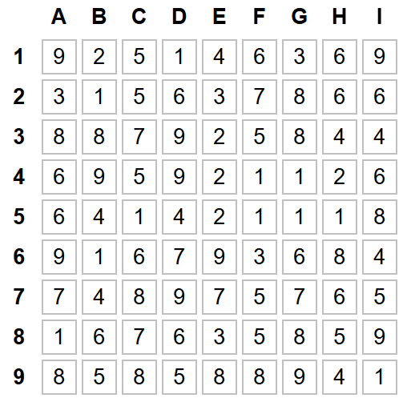
TRIO
Grille 1

Slide 2
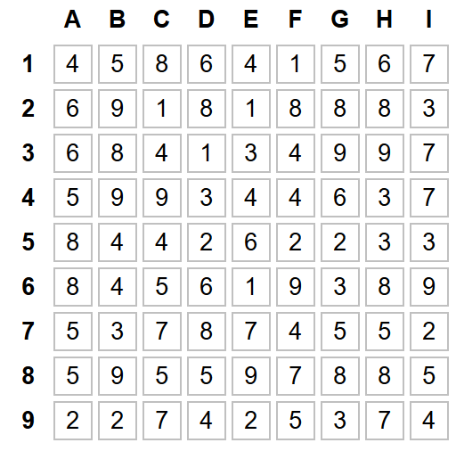
TRIO
Grille 2

Slide 3
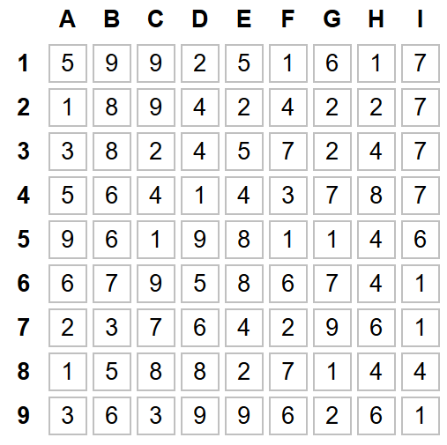
TRIO
Grille 3

Slide 4
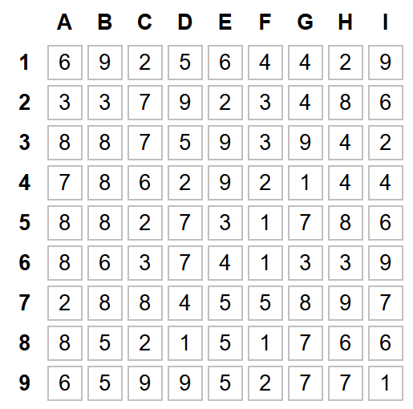
TRIO
Grille 4

Slide 5
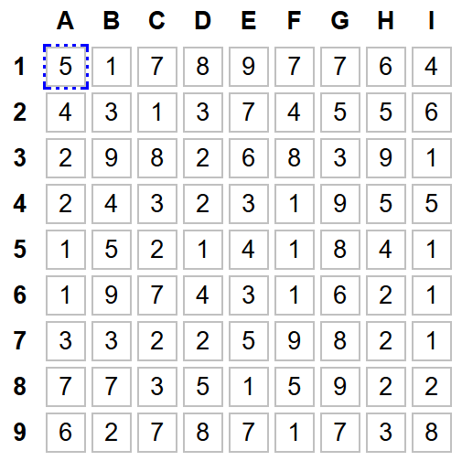
TRIO
Grille 5

Slide 6
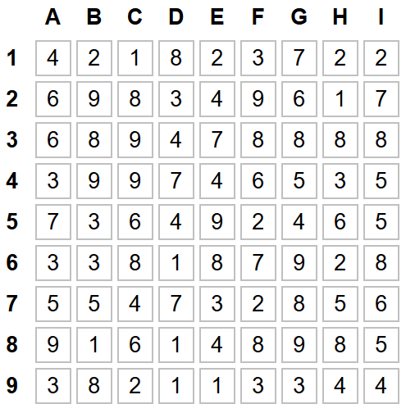
TRIO
Grille 6

Slide 7
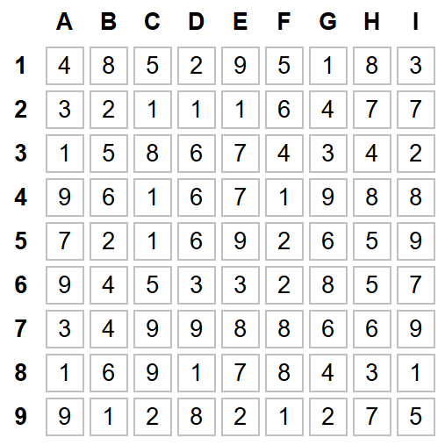
TRIO
Grille 7

Slide 8
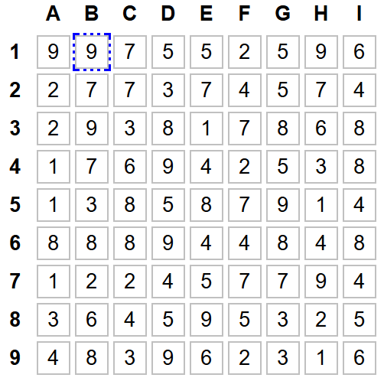
TRIO
Grille 8

Slide 9
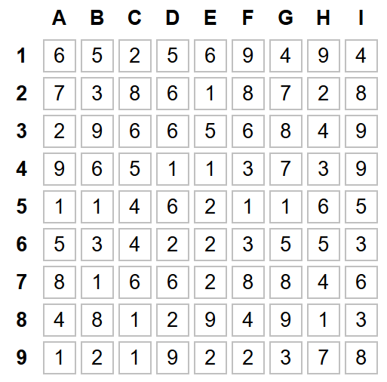
TRIO
Grille 9

Slide 10
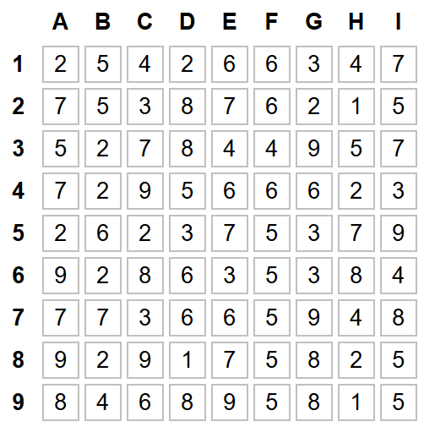
TRIO
Grille 10

